Slide 1
CS 408
Computer Networks
Graphical User Interface (GUI) in Python
Notes:
https://www.geeksforgeeks.org/python-gui-tkinter/
https://www.python-course.eu/tkinter_events_binds.php

Slide 2
Python GUI - tkinter
Python offers multiple options for developing GUI (Graphical User Interface)
Out of all, tkinter is the most commonly used one
Standard Python interface to the Tk GUI toolkit shipped with Python
Cross platform: same code works across different operating systems
To create a tkinter:
Import the module → tkinter
Create the main window (container)
Add any number of widgets to the main window
Apply the event Trigger on the widgets

Slide 3
Python GUI - tkinter
Importing tkinter
import tkinter
import tkinter as tk
from tkinter import *
Basic Usage
Tk(screenName=none, baseName=None, className=”Tk”, useTk=1)
To create a main window
Add widgets and event binds (we will see soon)
mainloop()
Used when ready for the application to run
Infinite loop to run the application → waits for an event to happen and processes that event

Slide 4
Python GUI - tkinter
Offers access to the geometric configuration of the widgets
pack() → organize the widget in blocks before placing in the parent widget
grid() → organize widgets in grid (table-like) structure before placing them
place() → organize widgets by placing them on specific positions
Different types of widgets (18)
Button → Button(master, option=value)
Entry → Entry(master, option=value)
Label → Label(master, option=value)
Listbox → Listbox(master, option=value)
Message → Message(master, option=value)
Scrollbar → Scrollbar(master, option=value)
Text → Text(master, option=value)
...

Slide 5
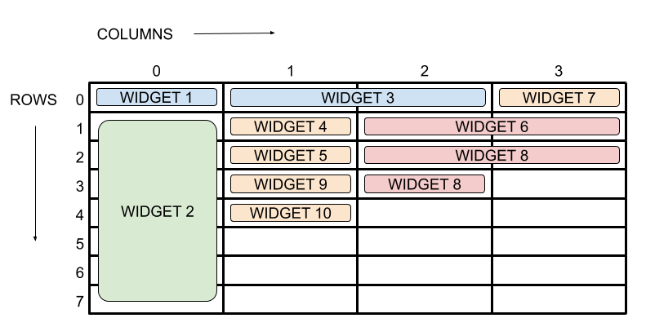
Python GUI - tkinter
Grid Layout manager
Notes:
https://www.pythonguis.com/tutorials/create-ui-with-tkinter-grid-layout-manager/

Slide 6
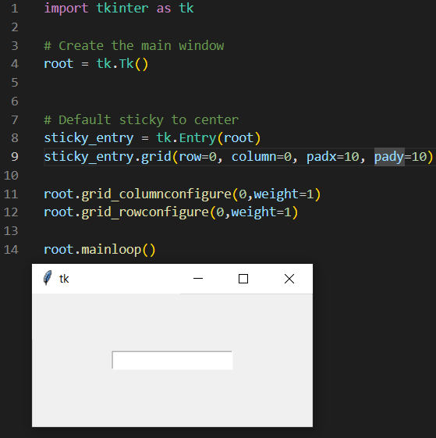
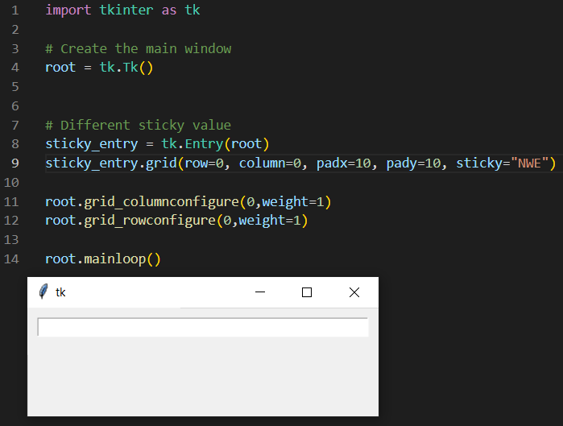
Python GUI - tkinter
Grid Layout manager
Notes:
https://www.pythonguis.com/tutorials/create-ui-with-tkinter-grid-layout-manager/

Slide 7
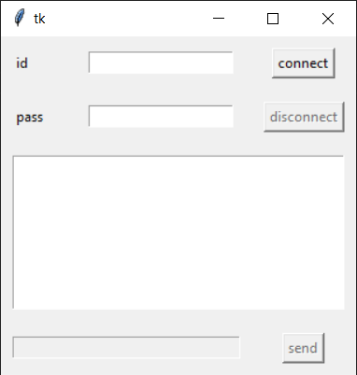
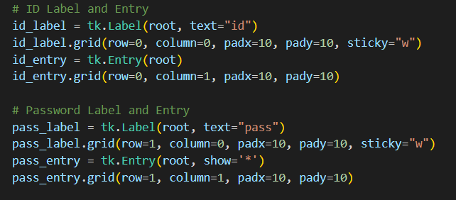
Python GUI - tkinter

Slide 8
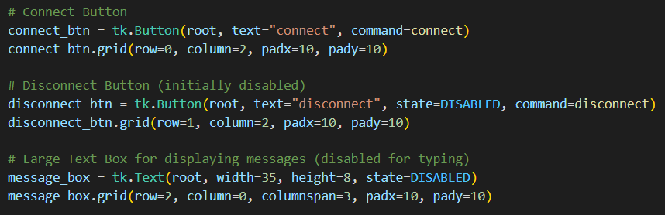
Python GUI - tkinter

Slide 9
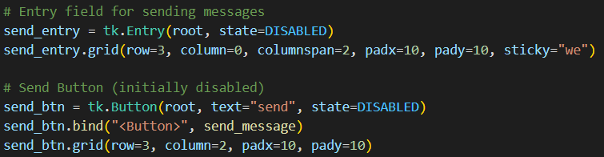
Python GUI - tkinter

Slide 10
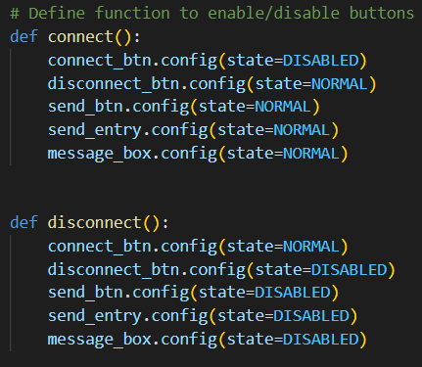
Python GUI - tkinter

Slide 11
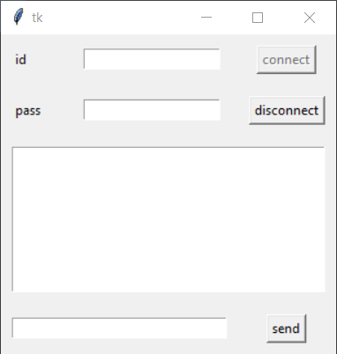
Python GUI - tkinter

Slide 12
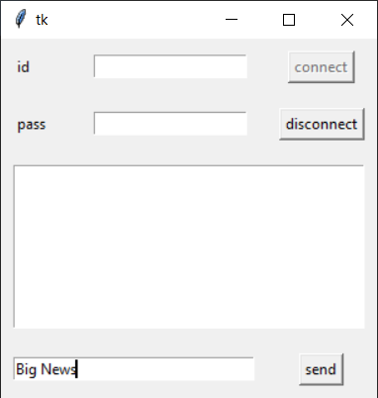
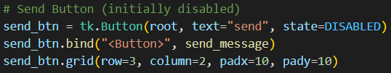
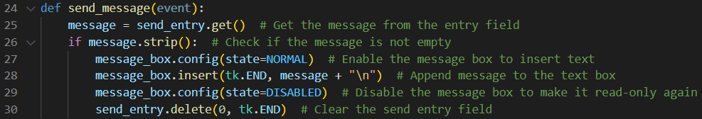
Python GUI - tkinter

Slide 13
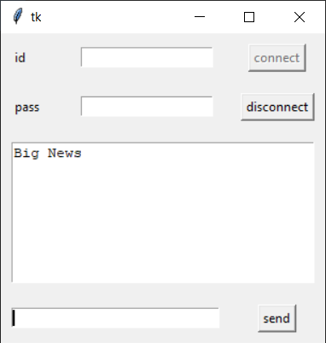
Python GUI - tkinter

Slide 14
Useful Links
https://www.geeksforgeeks.org/python-gui-tkinter/
https://www.python-course.eu/tkinter_events_binds.php
https://www.pythonguis.com/tutorials/create-ui-with-tkinter-grid-layout-manager/

